Slide 1
Better software faster
Powering DevOps Automation and Continuous Delivery
Process as Code: An Introduction to the ElectricFlow Automation DSL

Slide 2
Outline
Introduction
What is a DSL?
Why the excitement around EF DSL?
Use cases where process as code really shines
Benefits of code-based software delivery
Introduction to EF DSL
EF DSL examples
EF DSL editor
Conclusion
Q&A

Slide 3

Who am I?
Greg Maxey
Solutions Engineer at Electric Cloud, five years
Software Delivery Automation
Former Disciplines – a career in automation
Test and measurement
Signal processing and analysis
System level design
Integrated chip hardware design
Microprocessor and system on chip design
Network equipment testing

Slide 4
Show of hands
How many of you are involved in software delivery?
Are your primary tools UIs or code based / scripts?
Do you automate the automation?
How many of you are familiar with Electric Cloud?
How many of you are users or ElectricFlow?

Slide 5

































My job – DevOps Integration and Orchestration
Development
On success
promote &
notify QA & UAT
On success
notify release
team
Operations
Developers
Preflight
Build
CI
Build
QA/UAT
Provision Environment
Deploy
Testing
Staging
Deploy
Smoke test
Production
Changes
3
5
Start Release Pipeline
7
8
9
4
Infrastructure
On Preflight Success
Checkout
Checkout
Retrieve
Retrieve
Checkin
1
Coding
Local Builds
Local Testing
Checkout
6
Artifact
Management
2
SCM
Publish
Debug
Prod

Slide 6
Getting to software delivery automation
Applications that run the business
Business requirements and constraints
(SW Delivery Specifications)
Governance
Orchestration
Dev Ops
Infrastructure

Slide 7

































What Electric Cloud provides
BUILD/TEST
FLEXIBLE AND SCALABLE AUTOMATION FOR DEV AND QA
DEPLOY
ANY APP. ANY VERSION. ANYWHERE. ANYTIME.
RELEASE
TRADITIONAL AND CD PIPELINES AND RELEASES
OTHER
ORCHESTRATE ANY TOOLCHAIN OR PROCESS.
DSL, CLI, REST, SOAP, HTTP, API, SDK
DEV
OPS
ElectricFlow
DEVOPS AUTOMATION PLATFORM
SHARED CONTROL | SHARED VISIBILITY | SHARED RESOURCES
EXTENSIBLE
SCALABLE
SECURE
FLEXIBLE
TRANSPARENT
HYBRID CLOUD
Plugs right in to
your existing tools

Slide 8
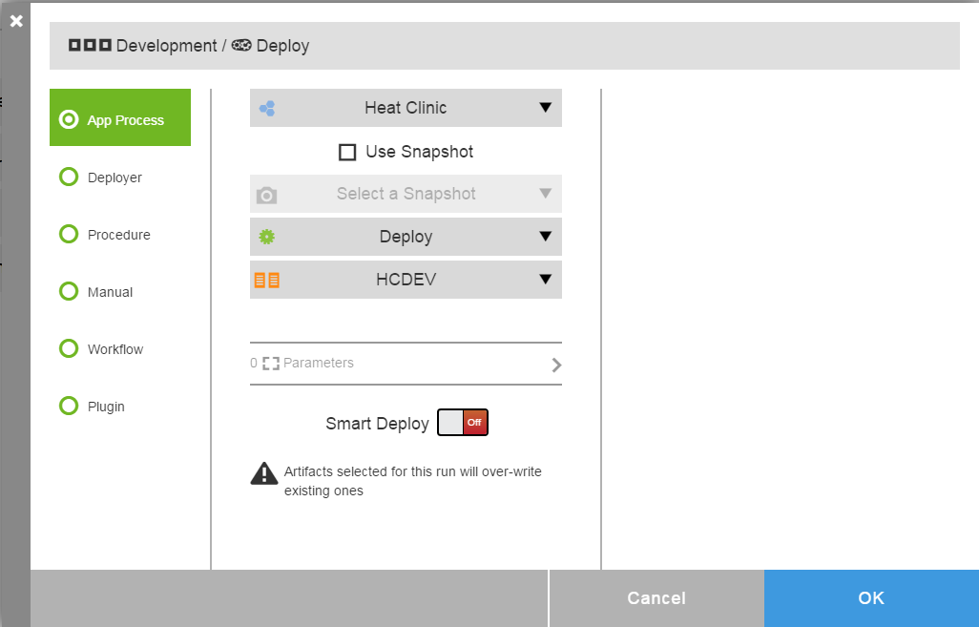
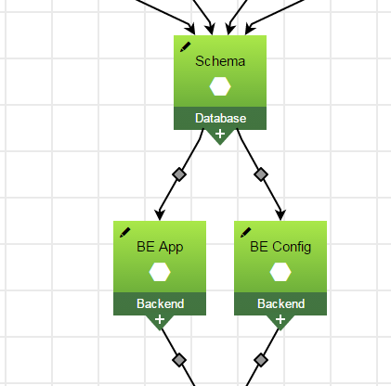
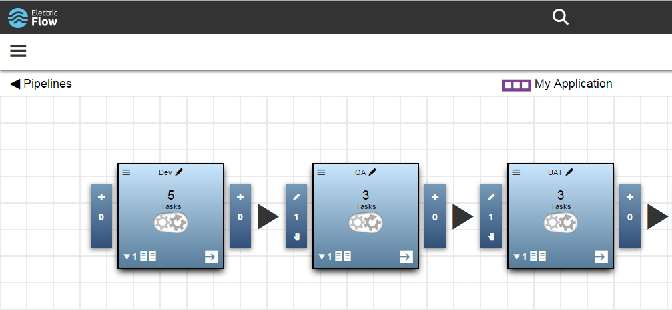
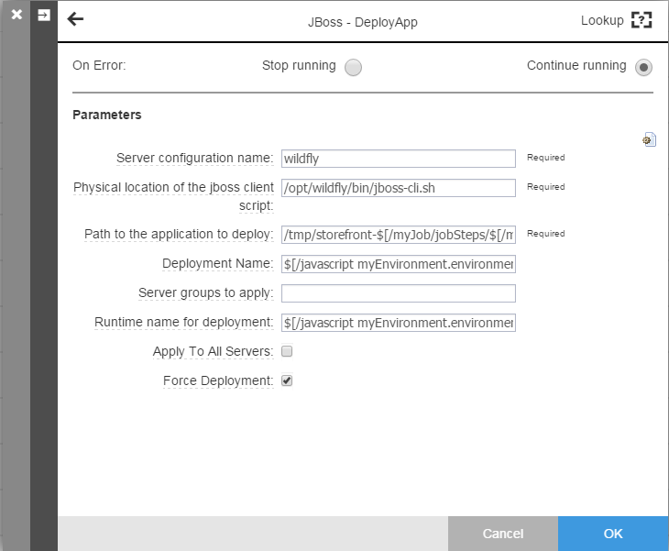
Modern user experience

Slide 9
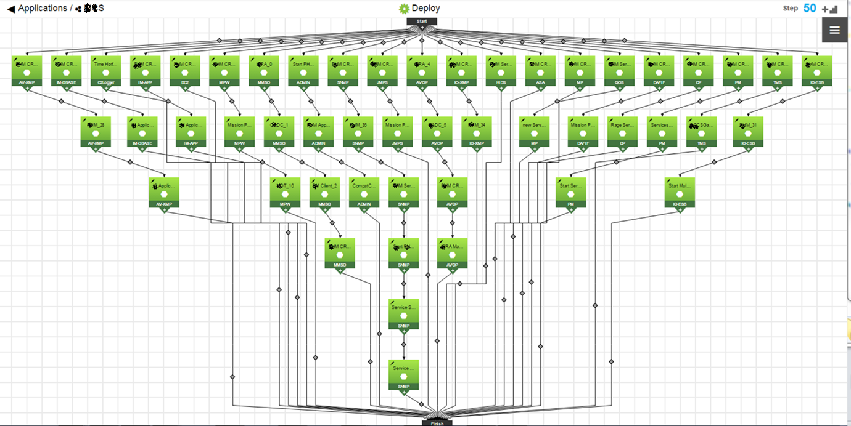
Application Model

Slide 10
What is a DSL?
A domain-specific language (DSL) is a computer language specialized to a particular application domain. This is in contrast to a general-purpose language (GPL), which is broadly applicable across domains, and lacks specialized features for a particular domain… DSLs can be further subdivided by the kind of language, and include domain-specific markup languages, domain-specific modeling languages (more generally, specification languages), and domain-specific programming languages. - Wikipedia

Slide 11


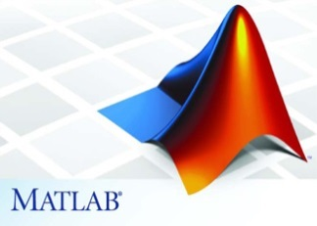
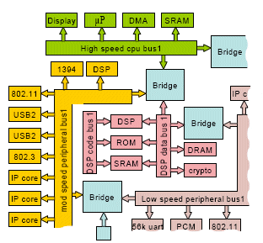

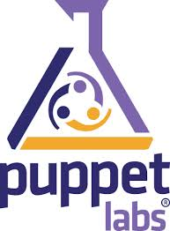

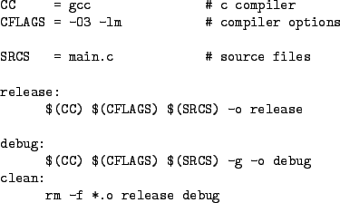

Examples of DSLs
HTML for webpage definition
MATLAB for mathematical modeling
Verilog, SystemC, LISA for SoC and uProcessor design
Regex for text pattern matching
make & ant for build automation
Chef & Puppet for compute infrastructure, Infrastructure as Code
But what for software delivery automation?

Slide 12

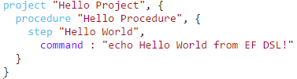
Why am I excited about DSL?
Electric Flow DSL
Easy to learn
Compact
Declarative
Idempotent
Inheritance
→ Very fast design capture
Anders Wallgren, CTO Electric Cloud

Slide 13
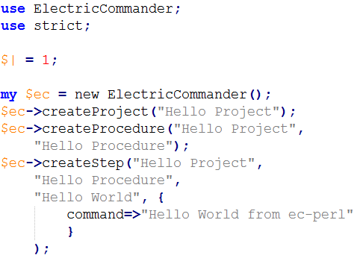
How I used to code in ElectricFlow
Notes:
use strict;
use ElectricCommander;
$| = 1;
$ec->createProject("Hello Project");
$ec->createProcedure("Hello Project",
"Hello Procedure");
$ec->createStep("Hello Project",
"Hello Procedure",
"Hello World from ec-perl");
project "Hello Project", {
procedure "Hello Procedure", {
step "Hello World",
command: "echo Hello World from EF DSL!"
}
}

Slide 14
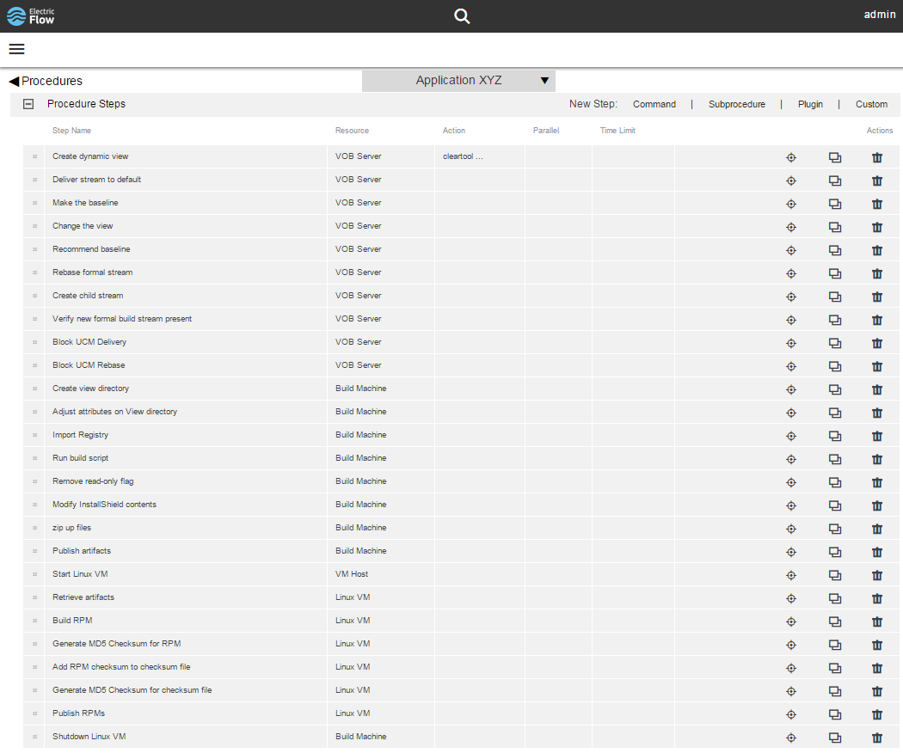
Configuration Management build Manual Run Book
PuTTY into VOB server
Create dynamic view
… (other VOB interactions)
Create local copy on build machine
Adjust permisions
Modify registry
Run build script
… (other file manipulations)
Start Linux VM
Copy build to VM
Create RPMs on VM
Create check sum
Copy RPMs to build machine
… (other file manipulations)
Burn CD
Notes:
Expected output, check box

Slide 15
Spin up a field-deployable datacenter
Do inventory of installation media
Power up
Verify networking is operational
Install the base services and infrastructure software
Install the main software components
Perform functional test subworkflow activity
Checkout XYZ functionality
Test and checkout
Verify component interoperability
Notes:
One of the largest aerospace/defense contractors

Slide 16
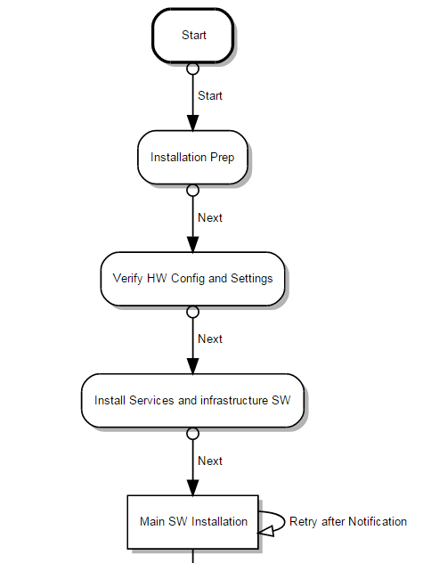
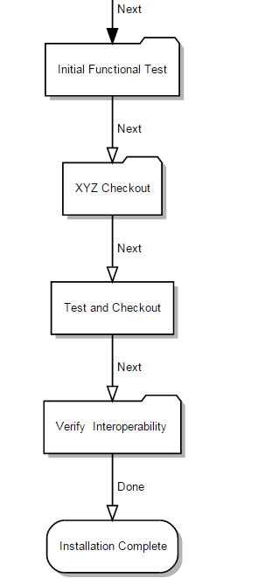
Top level installation workflow

Slide 17
When models get large
Servers | Services
TypeA | svs1, svs2, svs3
TypeB | svs1, svs4, svs5, svs6, svs7
TypeC | svs8, svs9
TypeD | svs8, svs10, svs11
TypeE | svs12
… | ..

Slide 18
Application Model

Slide 19
Onboard applications
Development
Continuous Integration
Continuous Deployment
Visual Studio
.NET
SCM
Code Analysis
Build
Unit Test
Artifact Management
Release Pipeline
QA
UAT
PROD
Eclipse
Java
xCode
Deploy Target Containers
IIS
Apprenda
Mac

Slide 20
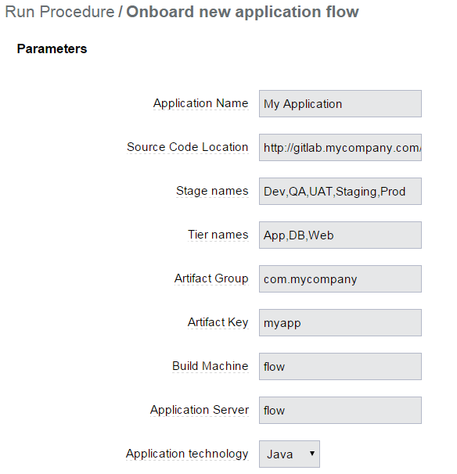
Onboarding Parameters
[
{
"name": "appName",
"label": "Application Name",
"description": "The name of the application to be onboarded",
"defaultValue": "My Application"
},
{
"name": "sourceLocation",
"label": "Source Code Location",
"description": "SCM location for CI",
"defaultValue": "http://gitlab.mycompany.com/apps/myapp.git"
},
{
"name": "stages",
"label": "Stage names",
"description": "Comma-separated list of stages for pipeline",
"defaultValue": "Dev,QA,UAT,Staging,Prod"
},
…

Slide 21
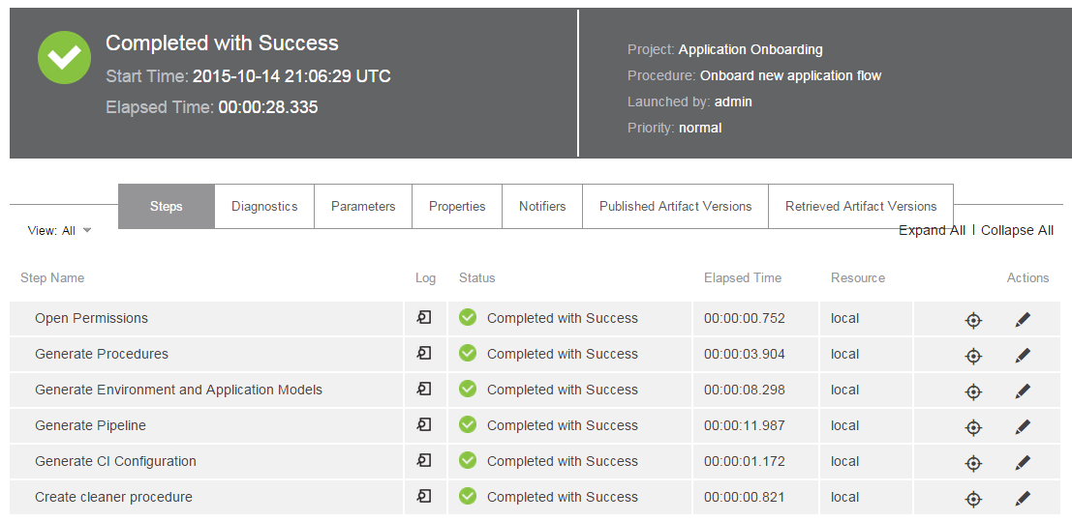
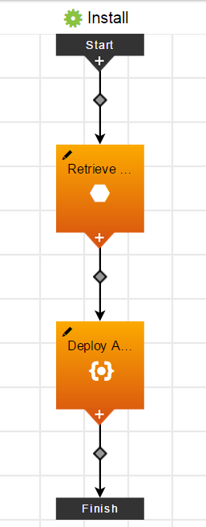
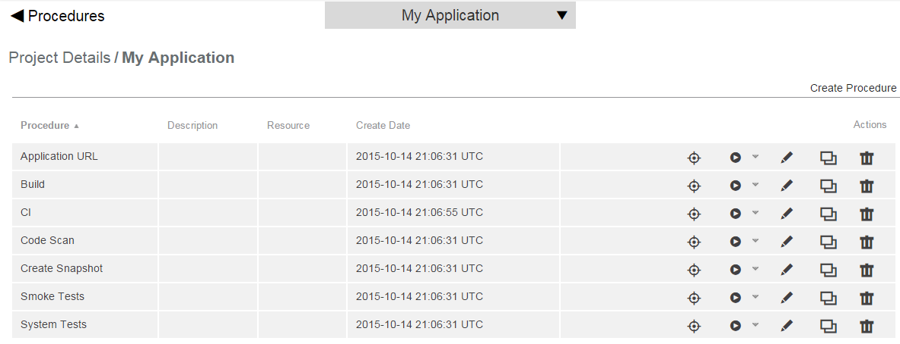
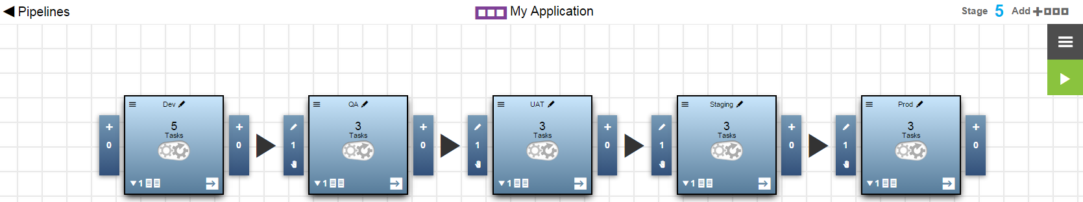
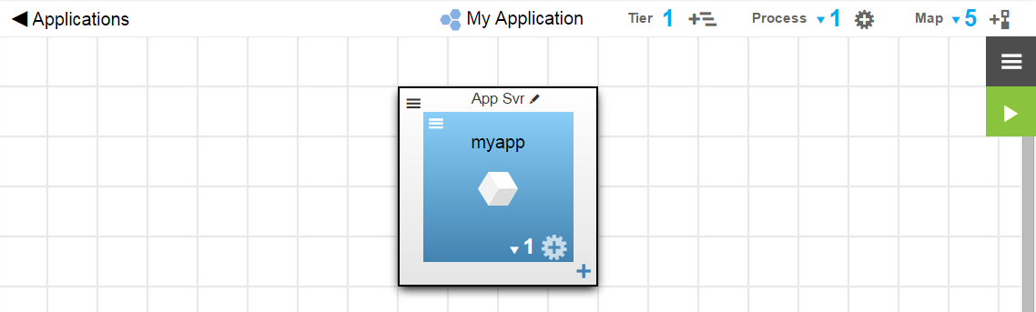
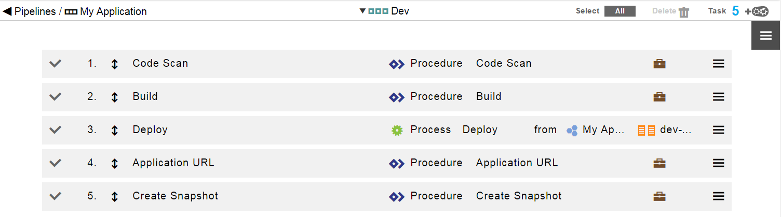
Automating the automation

Slide 22


Benefits of Code-based approaches
Leverage mature tool chains and best practices
IDEs
SCM / versioning
Modular design
Test-driven development
Static analysis and other code quality tools
Ease of Refactoring
Sharing / Collaboration
Scales well
Easier data-driven approaches

Slide 23
Benefits of EF DSL to enterprise software delivery
Documented process
Executable specification
Ease onboarding of new and legacy projects and teams
Ability to use mature code-based tools and approaches
Create and manage very complex delivery processes
Enable working at scale with teams of thousands
Matching the right interface to the particular user

Slide 24
ElectricFlow Domain Specific Language, EF DSL
Native access to ElectricFlow platform
Groovy-based, Domain Specific programming language
Supports entire EF API
Enables model authoring and scripting
And as said before
Easy to learn
Compact
Declarative
Idempotent
Inheritance

Slide 25
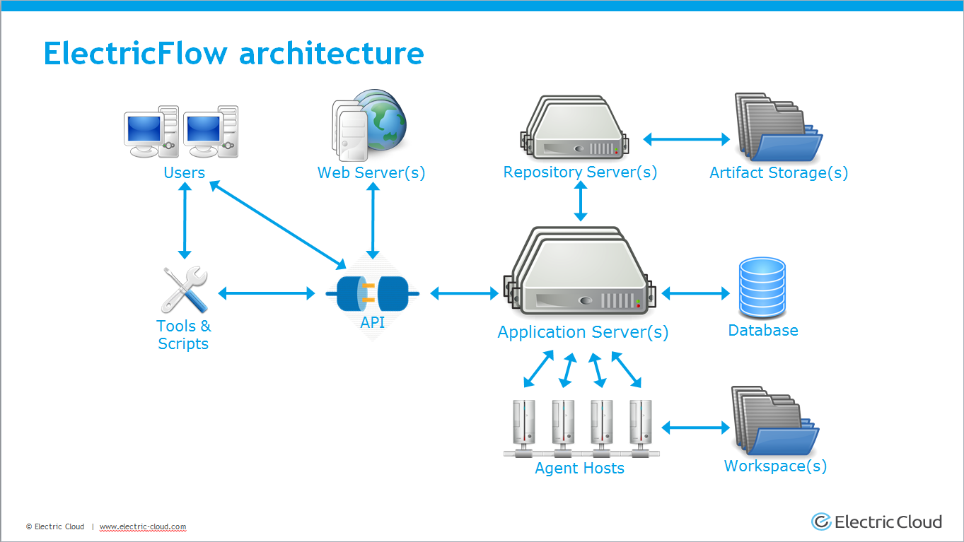
ElectricFlow platform addresses Process Automation
End-to-end software delivery automation through graphical/Web interface
Centralized
Secure
High scalability
Visibility
Traceable
Fault tolerant

Slide 26
EF DSL Examples - DEMO
Configuration Management Workflow
Onboarding legacy applications
Procedures
Environment models
Application models
Pipeline delivery discipline
Spinning up new projects
Training set up

Slide 27
DEMO

Slide 28
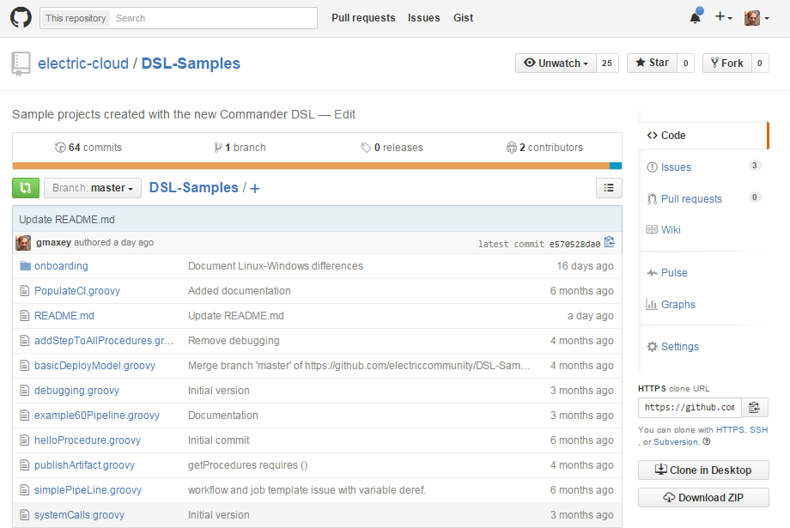
Samples on Github

Slide 29
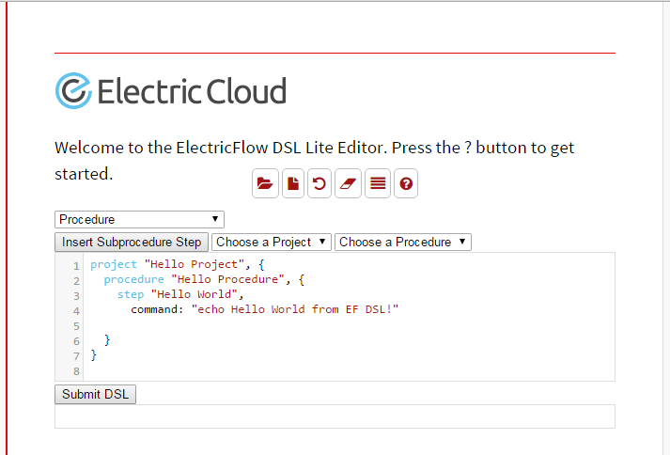
EF DSL IDE, Lite Editor - DEMO

Slide 30
DEMO

Slide 31
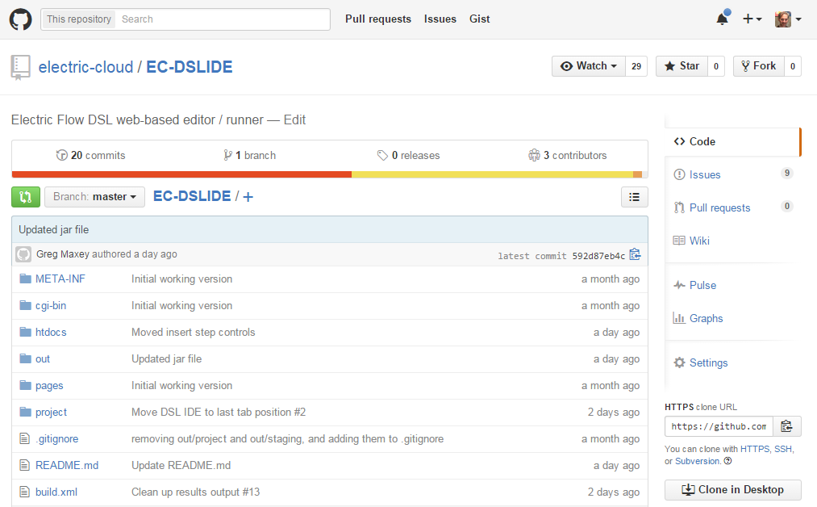
DSL IDE available on Github

Slide 32
Conclusion
When it comes to software delivery,
ElectricFlow UI is great for
Visualization
Medium Scale content authoring
For large-scale automating the automation EF DSL
Gives full access to ElectricFlow platform
Enables code-based authoring

Slide 33

























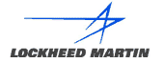


Thank you
Q&A
Networking
Mobile Devices
Semiconductor
ISV, Internet & Entertainment
Financial
Services
Automotive
Medical Devices
Aerospace / Defense
Heavy Industry
Other Systems

